Slide 1

Worshipful Masters
Workshop
Leadership Workshop January 27, 2018

Slide 2


Slide 3
Questions & Answers Session
Stand, Give Name, Lodge Name & No.
Index Cards from DDGM’s
Enter the topic and pass to the DDGM’s for Reading

Slide 4
Welcome
Thank You for Serving the Craft!
Prayer for Our Meeting
Pledge of Allegiance
Introduction of Officers

Slide 5
Grand Masters Topic
ISSUES FACING OUR FRATERNITY
Membership Retention EA’s FC’s
Aging Membership – 40 Year Life Membership
Financial Concerns with Some Lodges
Generational Conflict / Misunderstanding
Image of Freemasonry

Slide 6
Grand Masters topic
South Carolina Ritual is Our Only Ritual
7 Red Books – Worshipful Masters Responsibility
Never Given to a Candidate
Should Not Be Used in Open Lodge
Proficiency Requirement

Slide 7
Grand Masters Topics
Security Directive – EDICT 1
Check Dues Cards at All Meetings
Limited Use of Lodges on Sabbath
Raffles and Lotteries Limited
Alcohol in Lodges Prohibited - Liability

Slide 8
Grand Lodge Key Initiatives
Ritual Quality – Reading the Red Book, Practice
Candidate Proficiency – Full Proficiency
Improved Communications – Build contacts
Improved Masonic Education –
Community Service Project –

Slide 9
Grand masters Message
Report On Past Grand Masters
State of the Grand Jurisdiction “Opportunity and Optimism”
Lodge of the Future Program

Slide 10
Grand Masters Topics
Questions and Answers
How can we get our members to stay active?

Slide 11
General Instruction
Grand Secretaries Topics
MW Gerald L. Carver, PGM

Slide 12
Grand Secretary’s Topics
Grand Lodge Membership System
40 Year Life Membership Issues
Grand Lodge Reporting Process
Staff Support
Questions & Answers

Slide 13
Grand Secretary’s Topics
Grand Lodge Membership System
www.scgrandlodgeafm.org

Slide 14
General Instruction
Webmasters Topics
Wor. Mark Bennett, PM

Slide 15
Webmasters Message
Website Review www.scgrandlodgeafm.org
Policy and Procedure for Lodges
Facebook Process.
Questions & Answers

Slide 16
General Instruction
Fraternal Relations Committee
MW G. Kent Elkins, PGM

Slide 17
Fraternal Relations
CGMNA – Commission of Recognition
Standards of Recognition by Jurisdiction
Visitors ( List of Lodges )
Grand Lodge Approval
Questions & Answers

Slide 18
General Instruction
Masonic Protocol
RW Walter C. Cal Disher, II DGM

Slide 19
Deputy Grand Master
Masonic Protocol – Introductions
Grand Honors – Public and Private
Masonic Banquets Procedures
Questions & Answers

Slide 20
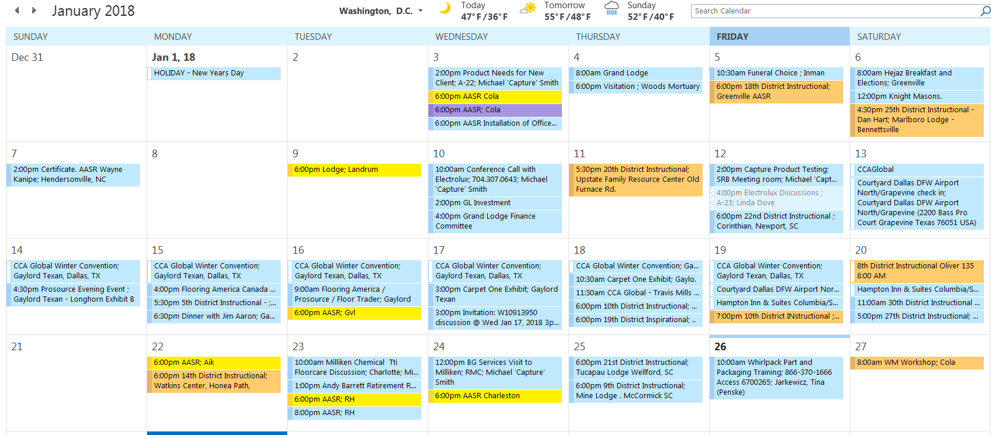
Deputy Grand Master

Slide 21
Senior Grand Warden
Masonic Education Committee
RW O. B. Smith, II, SGW

Slide 22
Senior Grand Warden Topics
Lodge System of Masonic Education
District Instructional Meetings
Materials for Educational Programs
Ahiman Rezon, Lodge of Future, Speakers,
Questions & Answers

Slide 23
Junior Grand Warden
Masonic Service Association
RW Steven D. Hames, JGW

Slide 24
Deputy Grand Master
Veterans Hospitals & Nursing Homes
Grand Lodge Visits and Results
Masonic Relief Appeals ~ $ 26,000
Educational Materials
Questions & Answers

Slide 25
General Instruction
Grand Treasurers Topics
MW Jack A. Marler, PGM

Slide 26
Grand Treasurer
Grand Lodge Budget & Per Capita
Endowment Funds
Perpetual Life Process
Grand Lodge Per Diem
Questions & Answers

Slide 27
Masonic Trials
Masonic Law & Jurisprudence
MW, D. Samuel Tennyson, PGM

Slide 28
Jurisprudence
Masonic Trial Process
Sec. 249 Expulsions
Chancellors
Questions & Answers

Slide 29
Luncheon
LUNCHEON BREAK
Replace Red Books - Library
Saleable Supplies Open – KSA Conf. Room
3 Lunch Presentations GWNMM – MW Barry Rickman, PGM Geo. Washington Portrait Project Grand Masters Projects Coins, Ties and Knife

Slide 30
Masonic Relief
Masonic Relief Process
MW, Ronald C. Mitchum, PGM

Slide 31
Masonic Relief
Sec 227 Code. AR. Definition
Application Process and Requirements.
Investigation and Approval
Pay Out Process
Reinvestigation

Slide 32
General instruction
Masonic Relief Process
MW, Ronald C. Mitchum, PGM

Slide 33
Grand Masters review
Planning for 2018 Year &
Grand Lodge Session
April 25 – 27, 2018

Slide 34
Review
Leading The Craft Forward
Establish the Vision, Understand the Key Issues
Establish the Standard of Excellence
Planning and Preparation for all meetings
Rehearsal and Practice
Recognition Publicly, Correct Privately

Slide 35
Review
2. How to Handle Confusion / Conflict?
Define the Issue. 3 Sides to every Story
Sit Down with the Parties & Lead Discussion
Listen and Take Notes. Verify Root Cause
Act to bring together.
Communicate
Follow Up with each party.

Slide 36
Review
3. How to Prepare for a Lodge OV
Discuss with DDGM What is Expected
Schedule a Date and Time for OV
Review the Check List in Advance
Verify and Complete the Checklist
Schedule a Visit to verify corrective action
Purpose is to protect the Lodge and GL

Slide 37
Grand Lodge Key Initiatives
Ritual Quality – Reading the Red Book, Practice
Candidate Proficiency – Full Proficiency
Improved Communications – Build contacts
Improved Masonic Education –
Community Service Project –

Slide 38
review
Planning for Grand Lodge Session
April 25 – 27, 2018
Attend and Enjoy
New Programs to Launch
Masters and Wardens Representatives

Slide 39
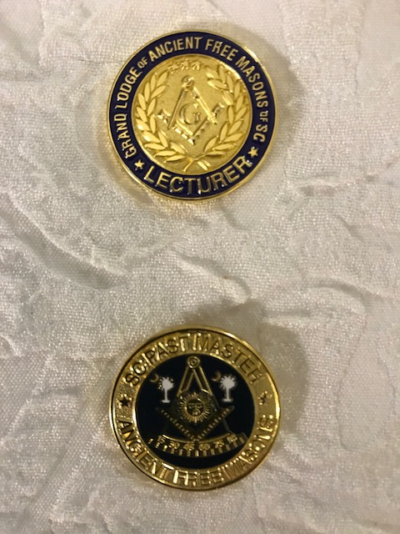
New Recognition
Recognition Pin for Lecturers Given by Grand Lodge to Individuals Standing Proficiency
New Past Masters Pin for all AFM Past Masters. Available at Grand Lodge Session.

Slide 40
Final Questions
Questions & Answers

Slide 41
Grand Masters Closing Ceremony

Slide 42
Grand Masters Closing Ceremony

Slide 43
Grand Masters Closing Ceremony

Slide 44
Grand Masters Closing Ceremony

Slide 45
Grand Masters Closing Ceremony
You Can Be THE Inspiration in your Lodge
You Will Make a Difference
Remember the 5 Points Of Fellowship
Obligation
Prayer for Success

